Slide 1
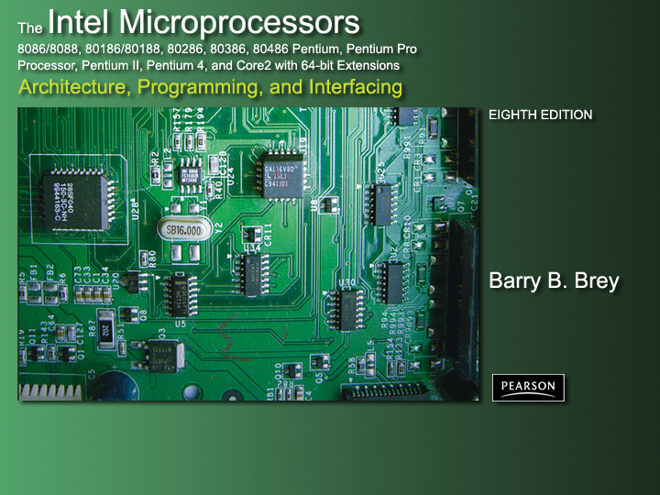
Chapter 12: Interrupts

Slide 2
Introduction
In this chapter, the coverage of basic I/O and programmable peripheral interfaces is expanded by examining a technique called interrupt-processed I/O.
An interrupt is a hardware-initiated procedure that interrupts whatever program is currently executing.
This chapter provides examples and a detailed explanation of the interrupt structure of the entire Intel family of microprocessors.

Slide 3
Chapter Objectives
Upon completion of this chapter, you will be able to:
Explain the interrupt structure of the Intel family of microprocessors.
Explain the operation of software interrupt instructions INT, INTO, INT 3, and BOUND.
Explain how the interrupt enable flag bit (IF) modifies the interrupt structure.
Describe the function of the trap interrupt flag bit (TF) and the operation of trap-generated tracing.

Slide 4
Chapter Objectives
(cont.)
Upon completion of this chapter, you will be able to:
Develop interrupt-service procedures that control lower-speed, external peripheral devices.
Expand the interrupt structure of the microprocessor by using the 82S9A
programmable interrupt controller and
other techniques.
Explain the purpose and operation of a real-time clock.

Slide 5
12–1 BASIC INTERRUPT PROCESSING
This section discusses the function of an interrupt in a microprocessor-based system.
Structure and features of interrupts available
to Intel microprocessors.

Slide 6
The Purpose of Interrupts
Interrupts are useful when interfacing I/O devices at relatively low data transfer rates, such as keyboard inputs, as discussed in Chapter 11.
Interrupt processing allows the processor to execute other software while the keyboard operator is thinking about what to type next.
When a key is pressed, the keyboard encoder debounces the switch and puts out one pulse that interrupts the microprocessor.

Slide 7
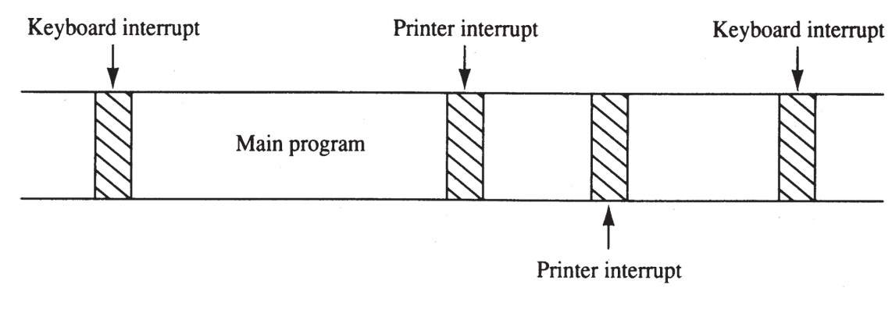
Figure 12–1 A time line that indicates interrupt usage in a typical system.
  a time line shows typing on a keyboard,
  a printer removing data from memory, and a program executing
  the keyboard interrupt service procedure, called by the keyboard interrupt, and the printer interrupt service procedure each take little time to execute

Slide 8
Interrupts
Intel processors include two hardware pins (INTR and NMI) that request interrupts…
And one hardware pin (INTA) to acknowledge the interrupt requested through INTR.
The processor also has software interrupts INT, INTO, INT 3, and BOUND.
Flag bits IF (interrupt flag) and TF (trap flag), are also used with the interrupt structure and special return instruction IRET
  IRETD in the 80386, 80486, or Pentium

Slide 9
Interrupt Vectors
Interrupt vectors and the vector table are crucial to an understanding of hardware
and software interrupts.
The interrupt vector table is located in
the first 1024 bytes of memory at addresses 000000H–0003FFH.
  contains 256 different four-byte interrupt vectors
An interrupt vector contains the address (segment and offset) of the interrupt service procedure.

Slide 10
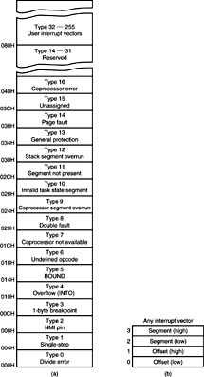
Figure 12–2 (a) The interrupt vector table for the microprocessor and (b) the contents of an interrupt vector.
  the first five interrupt vectors are identical
  in all Intel processors
  Intel reserves the first 32 interrupt vectors
  the last 224 vectors are user-available
  each is four bytes long in real mode and contains the starting address of the interrupt service procedure.
  the first two bytes contain the offset address
  the last two contain the segment address

Slide 11
Intel Dedicated Interrupts
Type 0
The divide error whenever the result from a division overflows or an attempt is made to divide by zero.
Type 1
Single-step or trap occurs after execution of each instruction if the trap (TF) flag bit is set.
  upon accepting this interrupt, TF bit is cleared
  so the interrupt service procedure executes at
  full speed

Slide 12
Type 2
The non-maskable interrupt occurs when a logic 1 is placed on the NMI input pin to the microprocessor.
  non-maskable—it cannot be disabled
Type 3
A special one-byte instruction (INT 3) that uses this vector to access its interrupt-service procedure.
  often used to store a breakpoint in a program
  for debugging

Slide 13
Type 4
Overflow is a special vector used with the INTO instruction. The INTO instruction interrupts the program if an overflow
condition exists.
  as reflected by the overflow flag (OF)

Slide 14
Type 5
The BOUND instruction compares a register with boundaries stored in the memory.
If the contents of the register are greater than or equal to the first word in memory and less than or equal to the second word, no interrupt occurs because the contents of the register are within bounds.
  if the contents of the register are out of bounds,
  a type 5 interrupt ensues

Slide 15
Type 6
An invalid opcode interrupt occurs when
an undefined opcode is encountered in a program.
Type 7
The coprocessor not available interrupt occurs when a coprocessor is not found, as dictated by the machine status word (MSW
or CR0) coprocessor control bits.
  if an ESC or WAIT instruction executes and no coprocessor is found, a type 7 exception or interrupt occurs

Slide 16
Type 8
A double fault interrupt is activated when
two separate interrupts occur during the
same instruction.
Type 9
The coprocessor segment overrun occurs
if the ESC instruction (coprocessor opcode) memory operand extends beyond offset address FFFFH in real mode.

Slide 17
Type 10
An invalid task state segment interrupt occurs in the protected mode if the TSS is invalid because the segment limit field is not 002BH or higher.
  usually because the TSS is not initialized
Type 11
The segment not present interrupt occurs when the protected mode P bit (P = 0) in a descriptor indicates that the segment is not present or not valid.

Slide 18
Type 12
A stack segment overrun occurs if the
stack segment is not present (P = 0) in the protected mode or if the limit of the stack segment is exceeded.

Slide 19
Type 13
The general protection fault occurs for
most protection violations in 80286–Core2
in protected mode system.
These errors occur in Windows as general protection faults.
A list of these protection violations follows.

Slide 20
Type 13 protection violations
  (a) Descriptor table limit exceeded
  (b) Privilege rules violated
  (c) Invalid descriptor segment type loaded
  (d) Write to code segment that is protected
  (e) Read from execute-only code segment
  (f) Write to read-only data segment
  (g) Segment limit exceeded
  (h) CPL = IOPL when executing CTS, HLT, LGDT, LIDT, LLDT, LMSW, or LTR
  (i) CPL > IOPL when executing CLI, IN, INS, LOCK, OUT, OUTS, and STI
(cont.)

Slide 21
Type 14
Page fault interrupts occur for any page
fault memory or code access in 80386, 80486, and Pentium–Core2 processors.
Type 16
Coprocessor error takes effect when a coprocessor error (ERROR = 0) occurs
for ESCape or WAIT instructions for 80386, 80486, and Pentium–Core2 only.

Slide 22
Type 17
Alignment checks indicate word and doubleword data are addressed at an odd memory location (or incorrect location, in the case of a doubleword).
  interrupt is active in 80486 and Pentium–Core2
Type 18
A machine check activates a system memory management mode interrupt in Pentium–Core2.

Slide 23
Interrupt Instructions: BOUND, INTO, INT, INT 3, and IRET
Five software interrupt instructions are available to the microprocessor:
INT and INT 3 are very similar.
BOUND and INTO are conditional.
IRET is a special interrupt return instruction.

Slide 24
BOUND has two operands, and compares a register with two words of memory data.
INTO checks or tests the overflow flag (O).
  If O = 1, INTO calls the procedure whose
  address is stored in interrupt vector type 4
  If O = 0, INTO performs no operation and the
  next sequential program instruction executes
The INT n instruction calls the interrupt service procedure at the address
represented in vector number n.

Slide 25
INT 3 instruction is often used as a breakpoint-interrupt because it is easy to insert a one-byte instruction into a program.
  breakpoints are often used to debug software
The IRET instruction is a special return instruction used to return for both software and hardware interrupts.
  much like a far RET, it retrieves the return address from the stack

Slide 26
Operation of a Real Mode Interrupt
When the processor completes executing the current instruction, it determines whether an interrupt is active by checking:
  (1) instruction executions
  (2) single-step
  (3) NMI
  (4) coprocessor segment overrun
  (5) INTR
  (6) INT instructions in the order presented

Slide 27
If one or more are present:
  1. Flag register contents are pushed on the stack
  2. Interrupt (IF) & trap (TF) flags clear, disabling the INTR pin and trap or single-step feature
  3. Contents of the code segment register (CS)
  are pushed onto the stack
  4. Contents of the instruction pointer (IP) are pushed onto the stack
  5. Interrupt vector contents are fetched and
  placed into IP and CS so the next instruction executes at the interrupt service procedure addressed by the vector

Slide 28
Operation of a Protected Mode Interrupt
In protected mode, interrupts have the same assignments as real mode.
  the interrupt vector table is different
In place of interrupt vectors, protected mode uses a set of 256 interrupt descriptors stored in an interrupt descriptor table (IDT).
  the table is 256 × 8 (2K) bytes long
  each descriptor contains eight bytes

Slide 29
The interrupt descriptor table is located at
any memory location in the system by the interrupt descriptor table address register (IDTR).
Each IDT entry contains the address of the interrupt service procedure
  in the form of a segment selector and a 32-bit offset address
  also contains the P bit (present) and DPL bits
  to describe the privilege level of the interrupt
Fig 12–3 shows interrupt descriptor contents.

Slide 30
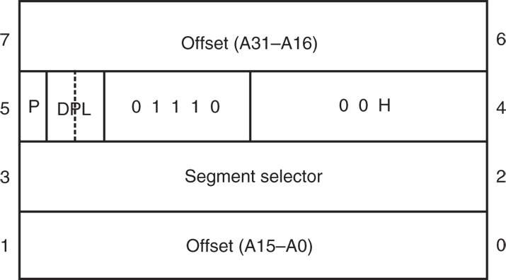
Figure 12–3 The protected mode interrupt descriptor.

Slide 31
Interrupt Flag Bits
The interrupt flag (IF) and the trap flag (TF) are both cleared after the contents of the flag register are stacked during an interrupt.
the contents of the flag register and the location of IF and TF are shown here
  when IF is set, it allows the INTR pin to cause
  an interrupt
  when IF is cleared, it prevents the INTR pin
  from causing an interrupt

Slide 32

Figure 12–4 The flag register. (Courtesy of Intel Corporation.)
  when TF = 1, it causes a trap interrupt (type 1)
  to occur after each instruction executes
  Trap is often called a single-step
  when TF = 0, normal program execution occurs
  the interrupt flag is set and cleared by the STI
  and CLI instructions, respectively
  the contents of the flag register and the location
  of IF and TF are shown here

Slide 33
Trace Procedure
Assuming TRON is accessed by an INT 40H instruction and TROFF is by an INT 41H instruction, Example 12–3 traces through a program immediately following the INT 40H instruction.
The interrupt service procedure illustrated in Example 12–3 responds to interrupt type 1
or a trap interrupt.

Slide 34
Storing an Interrupt Vector in the Vector Table
To install an interrupt vector—sometimes called a hook—the assembler must address absolute memory.
Example 12–4 shows how a new vector is added to the interrupt vector table using the assembler and a DOS function call.
Function AX = 3100H for INT 21H, installs
the NEW40 procedure until the PC is shut off.

Slide 35
12–2 HARDWARE INTERRUPTS
The two processor hardware interrupt inputs:
  non-maskable interrupt (NMI)
  interrupt request (INTR)
When NMI input is activated, a type 2
interrupt occurs
  because NMI is internally decoded
The INTR input must be externally decoded
to select a vector.

Slide 36
Any interrupt vector can be chosen for the INTR pin, but we usually use an interrupt
type number between 20H and FFH.
Intel has reserved interrupts 00H - 1FH for internal and future expansion.
INTA is also an interrupt pin on the processor.
  it is an output used in response to INTR input
  to apply a vector type number to the data bus connections D₇–D₀
Figure 12–5 shows the three user interrupt connections on the microprocessor.

Slide 37
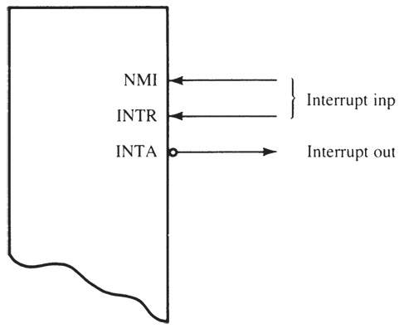
Figure 12–5 The interrupt pins on all versions of the Intel microprocessor.

Slide 38
The non-maskable interrupt (NMI) is an edge-triggered input that requests an interrupt on the positive edge (0-to-1 transition).
  after a positive edge, the NMI pin must remain logic 1 until recognized by the microprocessor
  before the positive edge is recognized, NMI pin must be logic 0 for at least two clocking periods
The NMI input is often used for parity errors and other major faults, such as power failures.
  power failures are easily detected by monitoring the AC power line and causing an NMI interrupt whenever AC power drops out

Slide 39
Figure 12–6 shows a power failure detection circuit that provides logic 1 to the NMI input whenever AC power is interrupted.
In this circuit, an optical isolator provides isolation from the AC power line.
The interrupt service procedure stores the contents of all internal registers and other data into a battery-backed-up memory.
This assumes the PC power supply has a large enough filter capacitor to provide energy for at least 75 ms after the AC power ceases.

Slide 40
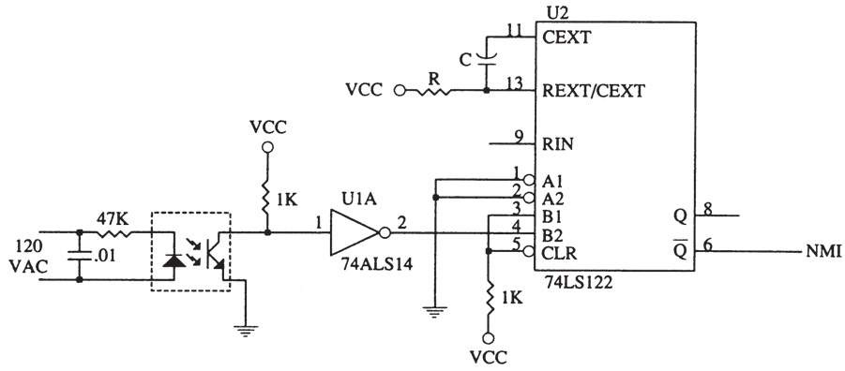
Figure 12–6 A power failure detection circuit.

Slide 41
Figure 12–7 shows a circuit that supplies power to a memory after the DC power fails.
  diodes are used to switch supply voltages from the DC power supply to the battery
When DC power fails, the battery provides a reduced voltage to the V_{CC} connection on the memory device.
Most memory devices will retain data with
V_{CC} voltages as low as 1.5 V, so the battery voltage does not need to be +5.0 V.

Slide 42
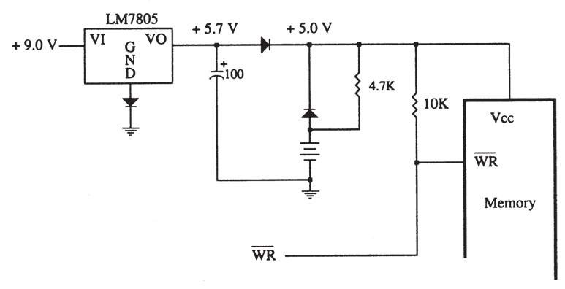
Figure 12–7 A battery-backed-up memory system using a NiCad, lithium, or gel cell.

Slide 43
INTR and INTA
The interrupt request input (INTR) is level-sensitive, which means that it must be held at a logic 1 level until it is recognized.
  INTR is set by an external event and cleared inside the interrupt service procedure
INTR is automatically disabled once accepted.
  re-enabled by IRET at the end of the interrupt service procedure
80386–Core2 use IRETD in protected mode.
  in 64-bit protected mode, IRETQ is used

Slide 44
The processor responds to INTR by pulsing INTA output in anticipation of receiving an interrupt vector type number on data bus connections D₇–D₀.
Fig 12–8 shows the timing diagram for the INTR and pins of the microprocessor.
Two INTA pulses generated by the system insert the vector type number on the data bus.
Fig12–9 shows a circuit to appy interrupt vector type number FFH to the data bus in response to an INTR.

Slide 45
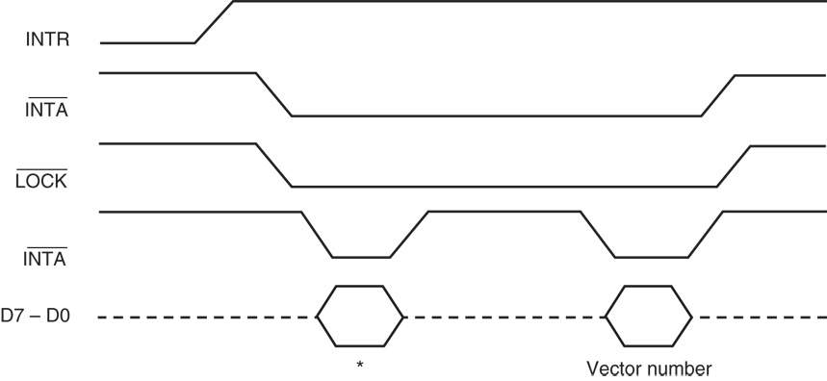
Figure 12–8 The timing of the INTR input and INTA output. *This portion of the data bus is ignored and usually contains the vector number.

Slide 46
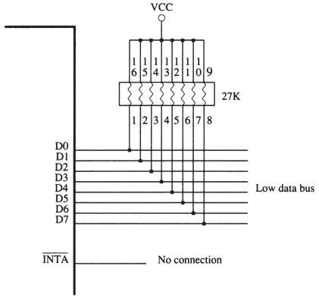
Figure 12–9 A simple method for generating interrupt vector type number FFH in response to INTR.

Slide 47
Using a Three-State Buffer for INTA
Fig 12–10 shows how interrupt vector type number 80H is applied to the data bus (D₀–D₇) in response to an INTR.
In response to INTR, the processor outputs the INTA to enable a 74ALS244 three-state octal buffer.
The octal buffer applies the interrupt vector type number to the data bus in response.
The vector type number is easily changed with DIP switches shown in this illustration.

Slide 48
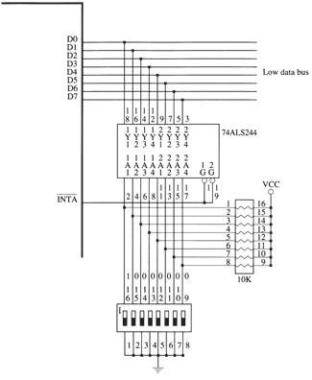
Figure 12–10 A circuit that applies any interrupt vector type number in response to
INTA. Here the circuit is applying type number 80H.

Slide 49
Making INTR Input Edge-Triggered
INTR input can be converted to an edge-triggered input by using a D-type flip-flop,
as illustrated in Figure 12–11.
Clock input becomes an edge-triggered interrupt request input, and the clear input is used to clear the request when the INTA signal is output by the microprocessor.
The RESET signal initially clears the flip-flop so that no interrupt is requested when the system is first powered.

Slide 50
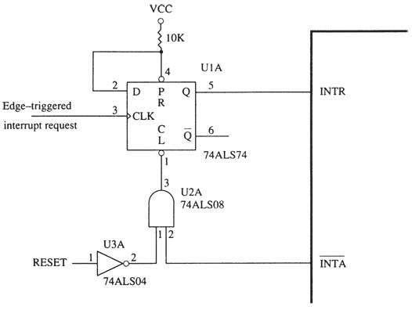
Figure 12–11 Converting INTR into an edge-triggered interrupt request input.

Slide 51
The 82C55 Keyboard Interrupt
Fig 12–12 shows interconnection of an
82C55 with the microprocessor and keyboard.
Every time a key is typed, 82C55 requests
a type 40H interrupt through the INTR pin.
Example 12–5 illustrates the interrupt
service procedure for the keyboard.
The procedure is short because the
processor already knows that keyboard data are available when the procedure is called.

Slide 52
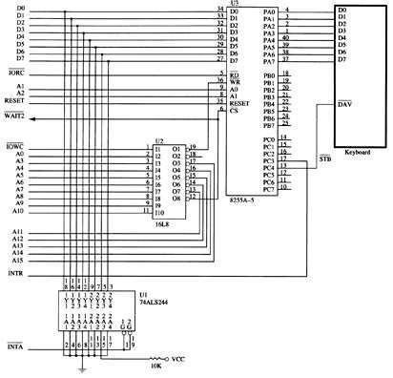
Figure 12–12 An 82C55 interfaced to a keyboard from the microprocessor system using interrupt vector 40H.

Slide 53
12–3 EXPANDING THE INTERRUPT STRUCTURE
This covers three common methods of expanding the interrupt structure
of the processor.
It is possible to expand the INTR input so
it accepts seven interrupt inputs.
Also explained is how to “daisy-chain”
interrupts by software polling.

Slide 54
Using the 74ALS244 to Expand Interrupts
The modification shown in Fig 12–13 allows the circuit of Fig 12–10 to accommodate up to seven additional interrupt inputs.
The only hardware change is the addition of an eight-input NAND gate, which provides the INTR signal to the microprocessor when any of the IR inputs becomes active.

Slide 55
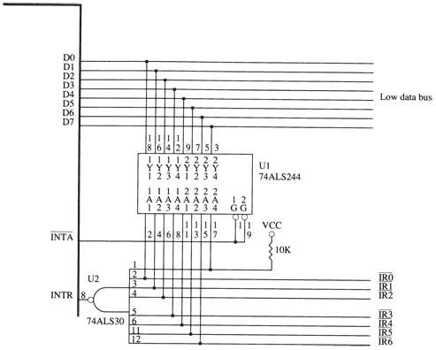
Figure 12–13 Expanding the INTR input from one to seven interrupt request lines.

Slide 56
Operation
If any of the IR inputs becomes logic 0, the output of the NAND gate goes to logic 1 and requests an interrupt through the INTR input.
The interrupt vector that is fetched during the pulse depends on which interrupt request line becomes active.
  Table 12–1 shows the interrupt vectors used
  by a single interrupt request input
If two or more interrupt requests are active active, a new interrupt vector is generated.

Slide 57
Daisy-Chained Interrupt
Expansion by a daisy-chained interrupt is in many ways better than using the 74ALS244.
  because it requires only one interrupt vector
Fig 12–14 shows a two 82C55 peripheral interfaces with their four INTR outputs daisy-chained and connected to the single INTR input of the processor.
If any interrupt output becomes logic 1, so does INTR input, causing an interrupt.

Slide 58
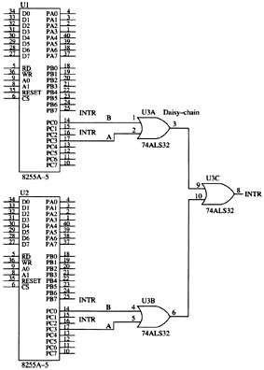
Figure 12–14 Two 82C55 PIAs connected to the INTR outputs are daisy-chained to produce an INTR signal.
  any INTR output from the two 82C55s will cause the INTR pin on the processor to go high, requesting an interrupt
  The task of locating which INTR output became active
  is up to the interrupt service procedure, which must poll the 82C55s to determine which output caused the interrupt

Slide 59
12–4 8259A PROGRAMMABLE INTERRUPT CONTROLLER
8259A (PIC) adds eight vectored priority encoded interrupts to the microprocessor.
Expandable, without additional hardware,
to accept up to 64 interrupt requests.
  requires a master 8259A & eight 8259A slaves
A pair of these controllers still resides and is programmed as explained here in the latest chip sets from Intel and other manufacturers.

Slide 60
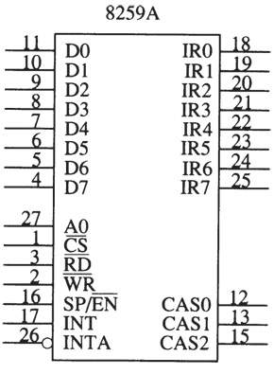
Figure 12–15 The pin-out of the 8259A programmable interrupt controller (PIC).
General Description of the 8259A
  8259A is easy to connect
  to the microprocessor
  all of its pins are direct connections except the
  CS pin, which must be decoded, and the WR pin, which must have an I/O bank write pulse

Slide 61
8259A Pin-Outs
D₀–D₇
The bidirectional data connections are normally connected to the data bus on the microprocessor.
IR₀–IR₇
Interrupt request inputs are used to request an interrupt and to connect to a slave in a system with multiple 8259As.

Slide 62
WR
The write input connects to write strobe signal (IOWC) on the microprocessor.
RD
The read input connects to the IORC signal.
INT
The interrupt output connects to the INTR pin on the processor from the master and is connected to a master IR pin on a slave.

Slide 63
INTA
Interrupt acknowledge is an input that connects to the INTA signal on the system.
In a system with a master and slaves, only
the master INTA signal is connected.
A₀
The A₀ address input selects different command words within the 8259A.

Slide 64
CS
Chip select enables the 8259A for programming and control.
CAS₀–CAS₂
The cascade lines are used as outputs
from the master to the slaves for cascading multiple 8259As in a system.

Slide 65
SP/EN
Slave program/enable buffer is a dual-function pin.
  when the 8259A is in buffered mode, this
  output controls the data bus transceivers
  in a large microprocessor-based system
  when the 8259A is not in the buffered mode,
  this pin programs the device as a master (1)
  or a slave (0)

Slide 66
Connecting a Single 8259A
Fig 12–16 shows a single 8259A connected to the microprocessor.
The 8259A is decoded at I/O ports 0400H and 0401H by the PLD.
The 8259A requires four wait states for it to function properly with a 16 MHz 80386SX
  more for some other versions of the Intel microprocessor family

Slide 67
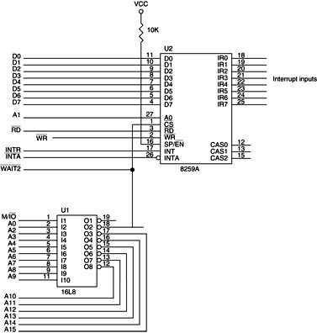
Figure 12–16 An 8259A interfaced to the 8086 microprocessor.

Slide 68
Cascading Multiple 8259As
Fig 12–17 shows two 8259As connected in a way often found in the ATX-style system.
  XT- or PC-style computers use a single 8259A controller at interrupt vectors 08H–0FH
The ATX-style computer uses interrupt vector 0AH as a cascade input from a second 8259A located at vectors 70H through 77H.
Appendix A contains a table that lists the functions of all the interrupt vectors used.

Slide 69
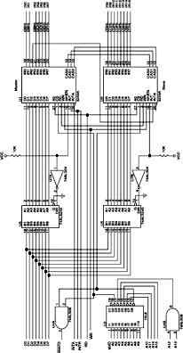
Figure 12–17 Two 8259As interfaced to the 8259A at I/O ports 0300H and 0302H for the master and 0304H and 0306H for the slave.
  this circuit uses vectors 08H–0FH & I/O ports 0300H & 0302H for
  U1, the master
  vectors 70H–77H & I/O ports 0304H & 0306H for U2, the slave
  data bus buffers to illustrate the use of the SP/EN pin on 8259A
  these buffers are used only in very large systems with many devices on their data bus connections
  seldom found in actual practice

Slide 70
Programming the 8259A
8259A is programmed by initialization
and operation command words.
Initialization command words (ICWs) are programmed before the 8259A is able to function in the system.
  dictate the basic operation of the 8259A
Operation command words (OCWs) are programmed during the normal course of operation.
  OCWs control the operation of the 8259A

Slide 71
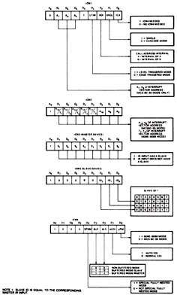
Figure 12–18 The 8259A initialization command words (ICWs). (Courtesy of Intel Corporation.)
Initialization Command Words
  the four initialization command words (ICWs) are selected when the A₀ pin is logic 1
  if a single 8259A is used in a system, ICW₁, ICW₂, and ICW₄ must be programmed when powered up
  if programmed in cascade mode
  by ICW₁, then ICW₃ must be programmed

Slide 72
ICW Descriptions - ICW₁
ICW₁ programs basic operation of the 8259A.
  selects single or cascade operation by programming the SNGL bit
  if cascade operation is selected, ICW₃ must
  also be programmed
  the LTIM bit determines whether interrupt
  request inputs are positive edge-triggered
  or level-triggered

Slide 73
ICW Descriptions - ICW₂
ICW₂ selects the vector number used with
the interrupt request inputs.
  if programming 8259A so it functions at
  vector locations 08H–0FH, place 08H into
  this command word
  if programming for vectors 70H–77H, place
  70H in this ICW

Slide 74
ICW Descriptions - ICW₃
ICW₃ is used only when ICW₁ indicates the system is operated in cascade mode.
  this ICW indicates where the slave is connected
  to the master. (In Figure 12–18 a slave was connected to IR₂ )
  to program ICW₃ for this connection, in both master and slave, place 04H in ICW₃
  if two slaves connected using IR₀ and IR₁, the master is programmed with an ICW₃ of 03H
  one slave is programmed with an ICW₃ of 01H and the other with an ICW₃ of 02H

Slide 75
ICW Descriptions - ICW₄
ICW₄ is programmed for use with the 8086–Pentium 4 processors, and the rightmost bit must be logic 1 to select operation with them.
Remaining bits are programmed as follows:
  SFNM—Selects the special fully nested mode
  of operation if logic 1 is placed in this bit
  BUF and M/S—Buffered and master slave are used together to select buffered operation or nonbuffered operation for the 8259A as a
  master or a slave

Slide 76
ICW Descriptions - ICW₄
(cont.)
Bit programming:
  AEOI—Selects automatic or normal end of interrupt. The EOI commands of OCW2 are
  used only if AEOI mode is not selected by ICW₄
  if AEOI is selected, the interrupt automatically resets the interrupt request bit and does not modify priority
  this is the preferred mode of operation for the 8259A and reduces the length of the interrupt service procedure

Slide 77
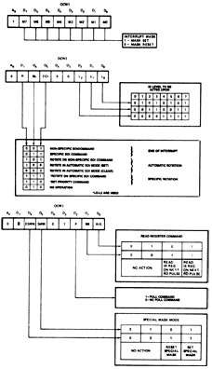
Figure 12–19 The 8259A operation command words (OCWs). (Courtesy of Intel Corporation.)
Operation Command Words
  used to direct 8259A operation once iprogrammed with the ICW
  OCWs are selected when the
  A₀ pin is at logic 0 level
  except OCW₁, which is
  selected when A₀ is logic 1
  shown here are the binary bit patterns for all three operation command words of the 8259A

Slide 78
OCW Descriptions - OCW₁
OCW₁ is used to set and read the interrupt mask register.
  when a mask bit is set, it will turn off (mask)
  the corresponding interrupt input
  the mask register is read when OCW₁ is read
  because the state of the mask bits is unknown when 8259A is first initialized, OCW₁ must be programmed after programming the ICW upon initialization

Slide 79
OCW Descriptions - OCW₂
OCW₂ is programmed only when the AEOI mode is not selected for the 8259A.
Selects the way 8259A responds to an interrupt. Modes are listed as follows:
  Nonspecific End-of-Interrupt—Command sent by the interrupt service procedure to signal the end of the interrupt
  8259A determines which interrupt level was active and resets the correct interrupt status register bit
  resetting the bit allows the interrupt to take action again or a lower priority interrupt to take effect

Slide 80
OCW Descriptions - OCW₂
(cont.)
OCW₂ interrupt modes:
  Specific End-of-Interrupt—A command that allows a specific interrupt request to be reset
  exact position determined with bits L₂–L₀
  of OCW₂

Slide 81
OCW Descriptions - OCW₂
(cont.)
OCW₂ interrupt modes:
  Rotate-on-Nonspecific EOI—functions exactly like the Nonspecific End-of-Interrupt command, except it rotates interrupt priorities after
  resetting the interrupt status register bit
  the level reset by this command becomes
  the lowest priority interrupt
  if IR₄ was just serviced by this command, it becomes the lowest priority interrupt input
  and IR₅ becomes the highest priority

Slide 82
OCW Descriptions - OCW₂
(cont.)
OCW₂ interrupt modes:
  Rotate-on-Automatic EOI—A command that selects automatic EOI with rotating priority
  must only be sent to the 8259A once if this
  mode is desired.
  if this mode must be turned off, use the clear command

Slide 83
OCW Descriptions - OCW₂
(cont.)
OCW₂ interrupt modes:
  Rotate-on-Specific EOI—Functions as the specific EOI, except that it selects rotating
  priority.
  Set priority—Allows the programmer to set
  the lowest priority interrupt input using the
  L₂–L₀ bits.

Slide 84
OCW Descriptions - OCW₃
OCW₃ selects register to be read, operation
of the special mask register & poll command.
  if polling is selected, the P bit must be set and then output to the 8259A; the next read
  operation will read the poll word
  the rightmost three bits of the word indicate the active interrupt request with the highest priority
  the leftmost bit indicates if there is an interrupt
  and must be checked to determine whether the rightmost three bits contain valid information

Slide 85
Status Register
Three status registers are readable in 8259A:
Interrupt request register (IRR).
  an 8-bit register that indicates which interrupt request inputs are active
In-service register (ISR).
  an 8-bit register that contains the level of the interrupt being serviced
interrupt mask register (IMR).
  an 8-bit register that holds the interrupt mask bits and indicates which interrupts are masked off

Slide 86
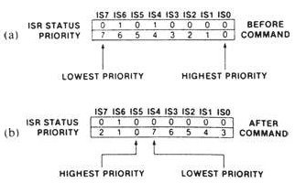
Figure 12–20 The 8259A in-service register (ISR). (a) Before IR₄ is accepted and (b) after IR₄ is accepted. (Courtesy of Intel Corporation.)

Slide 87
8259A Programming Example
Fig 12–21 shows 8259A connected to a
16550 programmable communications controller.
  the INTR pin from the 16550 is connected to
  the programmable interrupt controller’s interrupt request input IR₀
The 16550 is decoded at I/O ports 40H and 47H, and the 8259A is decoded at 8-bit I/O ports 48H and 49H.
Both are interfaced to the data bus of an 8088.

Slide 88
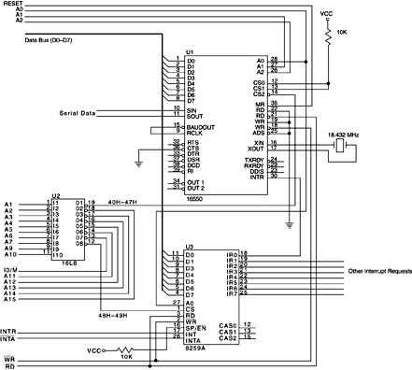
Figure 12–21 The 16550 UART interfaced to the 8088 microprocessor through the 8259A.

Slide 89
Initialization Software
The first portion of the software for this system must program both the 16550 and the 8259A.
  then enable the 8088 INTR pin so interrupts can take effect
Example 12–8 lists the software required to program both devices and enable INTR.
The software uses two memory FIFOs to
hold data for the transmitter and receiver.
  each FIFO is 16K bytes long and addressed
  by a pair of pointers (input and output)

Slide 90
INIT programs the 16550 UART for operation with seven data bits, odd parity, one stop bit, and a baud rate clock of 9600.
The second part of the procedure programs the 8259A, with its three ICWs and one OCW.
The final part enables the receiver and error interrupts of the 16550.
  transmitter interrupt not enabled until data are available for transmission
See Figure 12–22 for the contents of the interrupt control register of the 16550 UART.

Slide 91
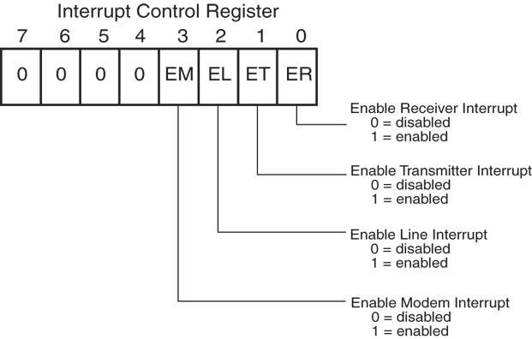
Figure 12–22 The 16550 interrupt control register.

Slide 92
Handling the 16550 UART Interrupt Request
16550 generates only one interrupt request
for various interrupts.
  so the interrupt handler must poll the 16550 to determine what type of interrupt has occurred
Accomplished by examining the interrupt identification register, shown in figure 12–23.
  the interrupt identification register (read-only) shares the same I/O port as the FIFO control register (write-only)

Slide 93
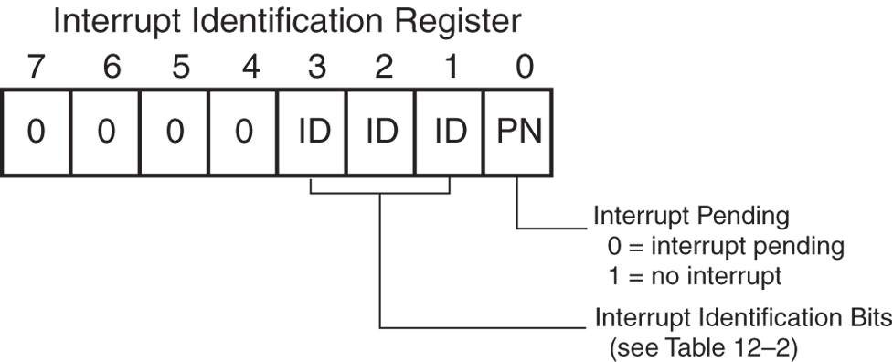
Figure 12–23 The 16550 interrupt identification register.

Slide 94
Receiving data from the 16550 requires two procedures.
  one procedure reads the data register of the 16550 each time the INTR pin requests an interrupt and stores it into the memory FIFO
  the other reads data from the FIFO from the
  main program
Example 12–10 lists the procedure used to read data from the memory FIFO from the main program.

Slide 95
Transmitting Data to the 16550
Data are transmitted to the 16550 in much
the same manner as they are received.
  except the interrupt service procedure removes transmit data from a second 16K-byte FIFO
Example 12–12 lists the procedure that fills the output FIFO.
It is similar to the procedure listed in
Example 12–10.
  except it determines whether the FIFO is full instead of empty

Slide 96
16550 also contains a general-purpose “scratch” register.
  it can be used in any way deemed necessary
  by the programmer
Also contained in the 16550 are a modem control register and a modem status register.
  these registers allow the modem to interrupt and control the operation of the 16550 with a modem
See Figure 12–24 for contents of both the modem status register and the modem
control register.

Slide 97
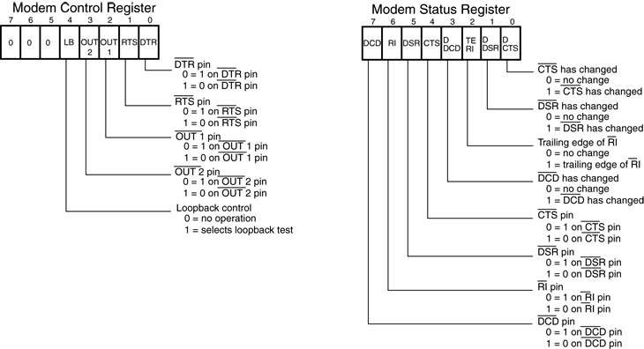
Figure 12–24 The 16550 modem control and modem status registers.

Slide 98
Figure 12–25 illustrates the 16550 UART, connected to an RS-232C interface often used to control a modem.
In order to transmit or receive data through the modem, the DTR pin is activated (logic 0).
The UART waits for the DSR pin to become logic 0, indicating the modem is ready.
When the modem is ready, it returns the signal CTS (logic 0) to the UART.
Communications can now commence.

Slide 99
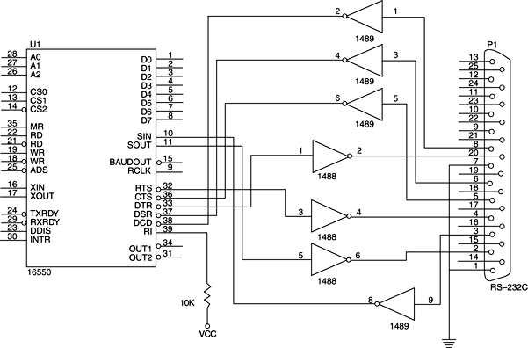
Figure 12–25 The 16550 interfaced to an RS-232C using 1488 line drivers and 1489 line receivers.

Slide 100
12–5 INTERRUPT EXAMPLES
This section presents a real-time clock and an interrupt-processed keyboard as examples of interrupt applications.
A real-time clock (RTC) keeps time in real
time; also used for precision time delays.
The interrupt-processed keyboard uses a periodic interrupt to scan through the keys
of the keyboard.

Slide 101
Real-Time Clock
Fig 12–26 shows a circuit using the 60 Hz AC power line to generate a periodic interrupt request signal for the NMI interrupt input pin.
You must make certain that the power line ground is connected to the system ground in this schematic.
  the power line neutral (white wire) connection
  is the wide flat pin on the power line
  the narrow flat pin is the hot (black wire) side
  or 120 V AC side of the line

Slide 102
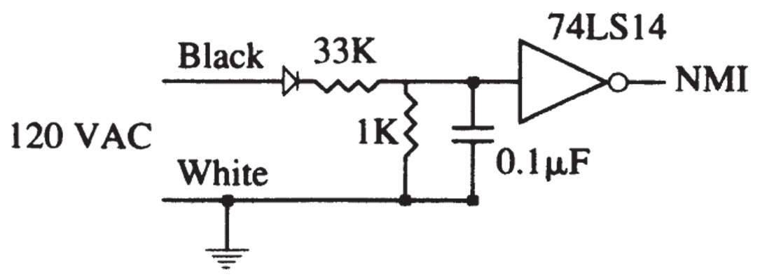
Figure 12–26 Converting the AC power line to a 60 Hz TTL signal for the NMI input.

Slide 103
The software for the real-time clock contains an interrupt service procedure that is called 60 times per second and a procedure that updates the count located in four memory locations.
Example 12–14 lists both procedures, along with the four bytes of memory used to hold the BCD time of day.
Another way to handle time is to use a single counter to store the time in memory and then determine the actual time with software.

Slide 104
Interrupt-Processed Keyboard
The interrupt-processed keyboard scans the keyboard through a periodic interrupt.
  on each interrupt occurs, the interrupt-service procedure tests for a key or debounces the key
Once a valid key is detected, the interrupt service procedure stores the key code into a queue for later reading by the system.
Figure 12–27 shows the keyboard interfaced to an 82C55 and Example 12–18 lists the interrupt service procedure for the keyboard.

Slide 105
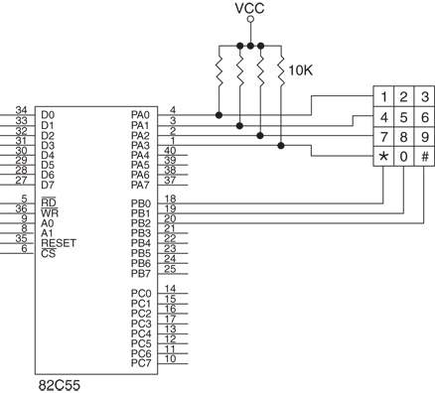
Figure 12–27 A telephone-style keypad interfaced to the 82C55.

Slide 106
SUMMARY
An interrupt is a hardware- or software-initiated call that interrupts the currently executing program at any point and calls
a procedure.
The procedure is called by the interrupt handler or an interrupt service procedure.
Interrupts are useful when an I/O device needs to be serviced only occasionally at low data transfer rates.

Slide 107
SUMMARY
(cont.)
The microprocessor has five instructions that apply to interrupts: BOUND, INT, INT 3, INTO, and IRET.
The INT and INT 3 instructions call procedures with addresses stored in the interrupt vector whose type is indicated by the instruction.
The BOUND instruction is a conditional interrupt that uses interrupt vector type number 5.

Slide 108
SUMMARY
(cont.)
The INTO instruction is a conditional interrupt that interrupts a program only
if the overflow flag is set.
Finally, the IRET, IRETD, or IRETQ instruction is used to return from interrupt service procedures.
The microprocessor has three pins that apply to its hardware interrupt structure.

Slide 109
SUMMARY
(cont.)
Real mode interrupts are referenced through a vector table that occupies memory locations 0000H-03FFH.
Each interrupt vector is four bytes long and contains the offset and segment addresses of the interrupt service procedure.
In protected mode, the interrupts reference the interrupt descriptor table (IDT) that contains 256 interrupt descriptors

Slide 110
SUMMARY
(cont.)
Two flag bits are used with the interrupt structure of the microprocessor: trap (TF) and interrupt enable (IF).
The IF flag bit enables the INTR interrupt input.
TF flag bit causes interrupts to occur after the execution of each instruction, as long as TF is active.

Slide 111
SUMMARY
(cont.)
The first 32 interrupt vector locations are reserved for Intel use, with many prede-fined in the microprocessor.
The last 224 interrupt vectors are for the user's use and can perform any function desired.

Slide 112
SUMMARY
(cont.)
Whenever an interrupt is detected, the following events occur:
(1) the flags are pushed onto the stack
(2) the IF and TF flag bits are both cleared
(3) the IP and CS registers are both pushed onto the stack
(4) the interrupt vector is fetched from the interrupt vector table and the interrupt service subroutine is accessed through
the vector address

Slide 113
SUMMARY
(cont.)
Tracing or single-stepping is accomplished by setting the TF flag bit.
This causes an interrupt to occur after the execution of each instruction for debugging.
The non-maskable interrupt input (NMI) calls the procedure whose address is stored at interrupt vector type number 2.
This input is positive edge-triggered.

Slide 114
SUMMARY
(cont.)
The INTR pin is not internally decoded, as is the NMI pin.
Methods of applying the interrupt vector type number to the data bus vary widely.
One method uses resisters to apply interrupt type number FFH to the data bus, while another uses a three-state buffer to apply any vector type number.

Slide 115
SUMMARY
(cont.)
The 8259A programmable interrupt controller (PIC) adds at least eight interrupt in-puts to the microprocessor.
If more interrupts are needed, this device can be cascaded to provide up to 64 interrupt inputs.

Slide 116
SUMMARY
(cont.)
Programming the 8259A is a two-step process.
First, a series of initialization command words (ICWs) are sent to the 8259A,
Second, a series of operation command words (OCWs) are sent.

Slide 117
SUMMARY
The 8259A contains three status registers: IMR (interrupt mask register)
ISR (in-service register)
IRR (interrupt request register).
A real-time clock is used to keep time in real time. In most cases, time is stored in either binary or BCD form in several memory locations.

